Slide 1

Global Population Trends (1960–2022): Insights and Analysis
A Data-Driven Exploration of Demographics and Their Impacts
Name – Sumit Baviskar
Date – 12 Jan 2025

Slide 2
Project Overview
Objective: Understand global population trends, regional dynamics, and income-based distributions.
Methodology: Data cleaning, analysis, and visualization using bar plots and histogram

Slide 3
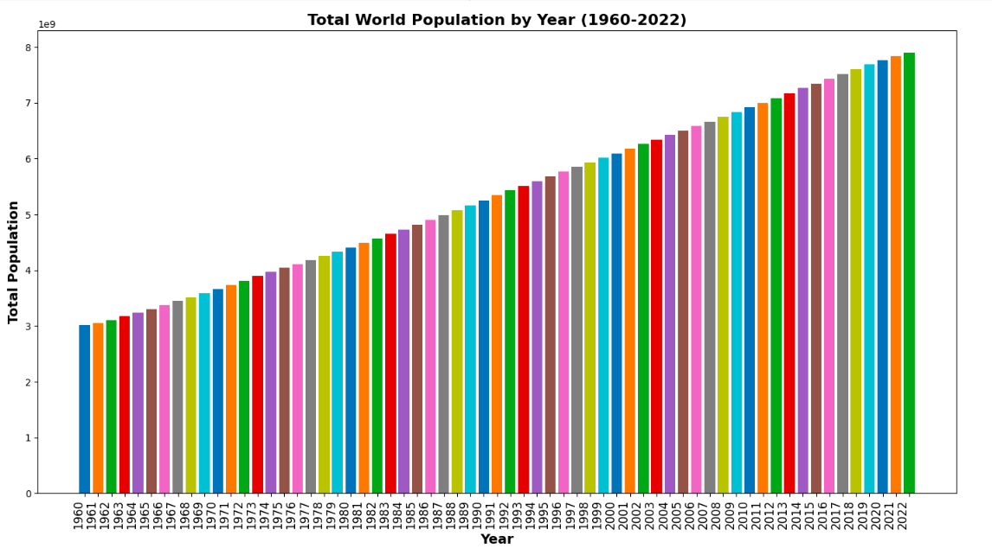
World Population Growth (1960–2022)
Peak Growth: 1963–1971 with >2% annual growth.
Decline: Growth rate fell below 1% post-2020, impacted by global events.
Demographic shift toward stabilization in many regions.

Slide 4
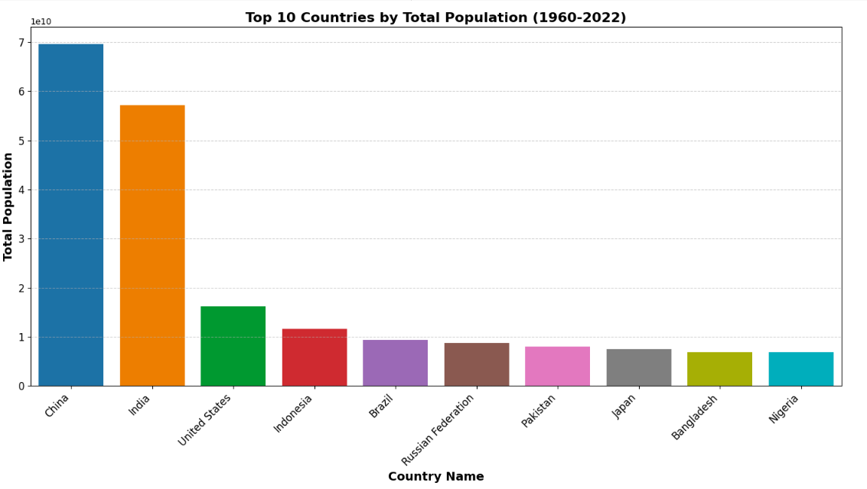
Top 10 Most Populous Countries (1960–2022)
China and India consistently lead, contributing over 35% of the global population.
India surpasses China in 2022.
Stagnant growth in developed countries like Japan and Russia.

Slide 5
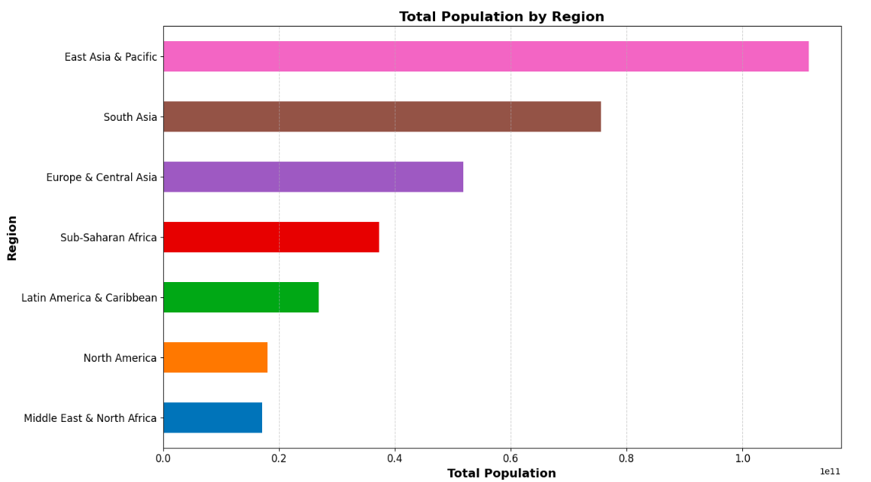
Population Trends by Region
South Asia: Rapid growth driven by India, Pakistan, and Bangladesh.
Sub-Saharan Africa: Significant growth potential, led by Nigeria.
Europe & Central Asia: Stagnant or declining populations.
Key regions: East Asia & Pacific dominate global population share.

Slide 6
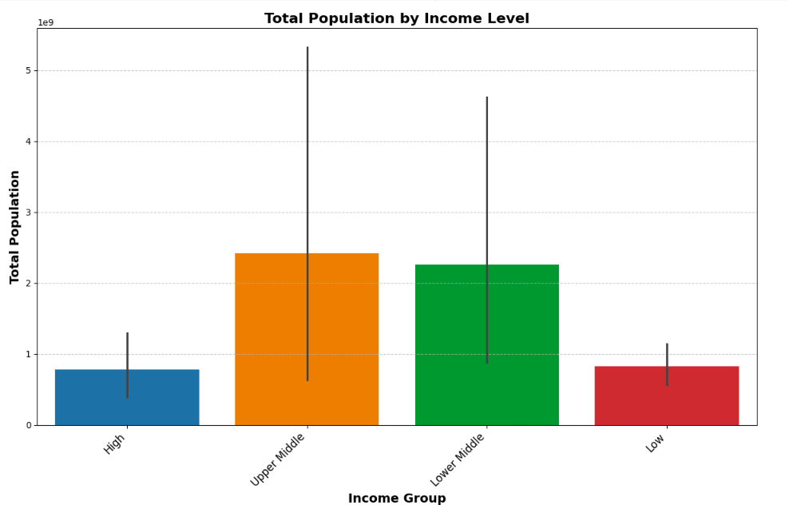
Distribution of Population by Income Levels
Lower- and upper-middle-income groups: Largest population segments.
High-income group: Smallest share of global population.
Opportunities exist for economic development in lower-income countries.
Reflects global economic disparity and development opportunities.

Slide 7
Key Insights and Opportunities
Opportunities in High-Growth Regions: South Asia and Sub-Saharan Africa show immense potential for growth and investment.
Challenges in Stagnating Regions: Aging populations in Europe and North America necessitate innovation.
Demographic Dividend:Young populations in Africa and Asia could drive economic growth.

Slide 8
Conclusion
Global population growth is slowing, but regional dynamics are diverse.
High-growth regions present challenges and opportunities.
Strategic investments in education, healthcare, and infrastructure are critical to leveraging demographic changes.
Call to Action: How can we better plan for the future of a diverse and evolving global population?"

Slide 9
Questions and Discussion
Open the floor for questions.
Thank the audience for their time and participation.

